Slide 1
Do Socioeconomic Factors affect School Performance?
By: Julie Mammen

Slide 2
Introduction
Address the inequality of education opportunities in U.S. high schools
Focus on average performance on ACT/SAT exams
Do socioeconomic factors affect school performance?

Slide 3
Data Sources
Edgap - information about average ACT/SAT scores for schools with socioeconomic characteristics of the school district.
School Information - basic information about each school from the National Center for Education Statistics

Slide 4
Analysis
Joining data frames
Single Input Models
Multiple Input Models
Regression Models
Analyze r-squared, p-values, z-scores

Slide 5
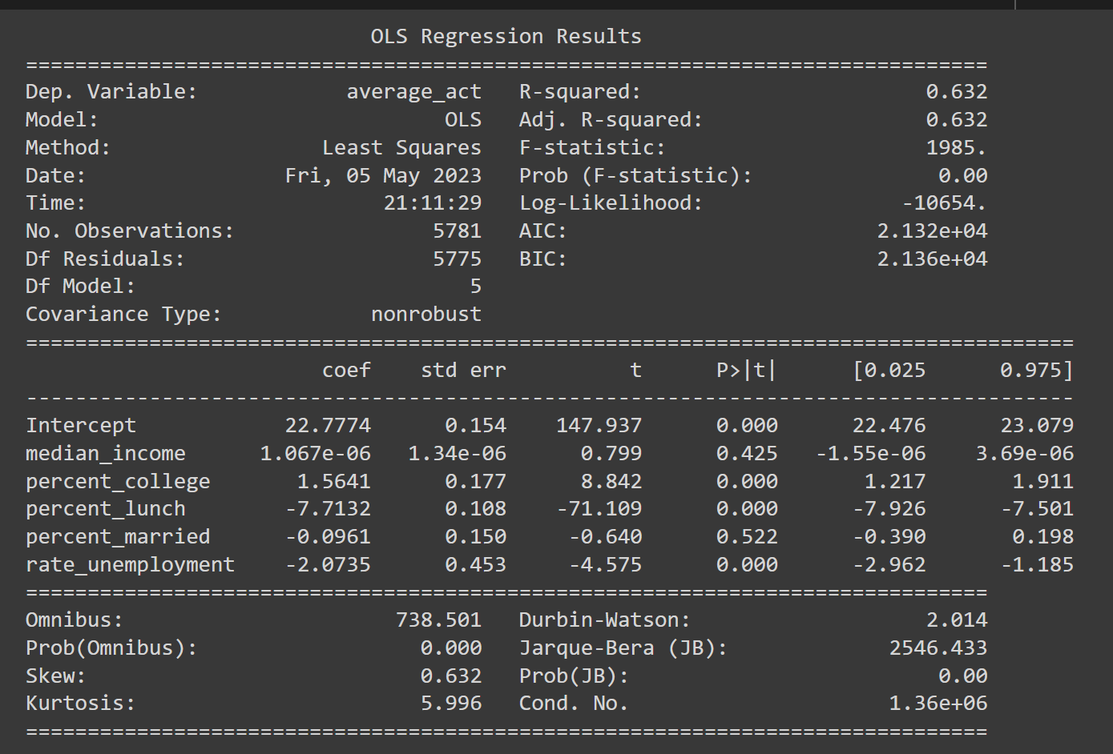
Results
The multiple input models highlights which predictors are of significance for analysis.
Percent_college, percent_lunch, rate_unemployment

Slide 6
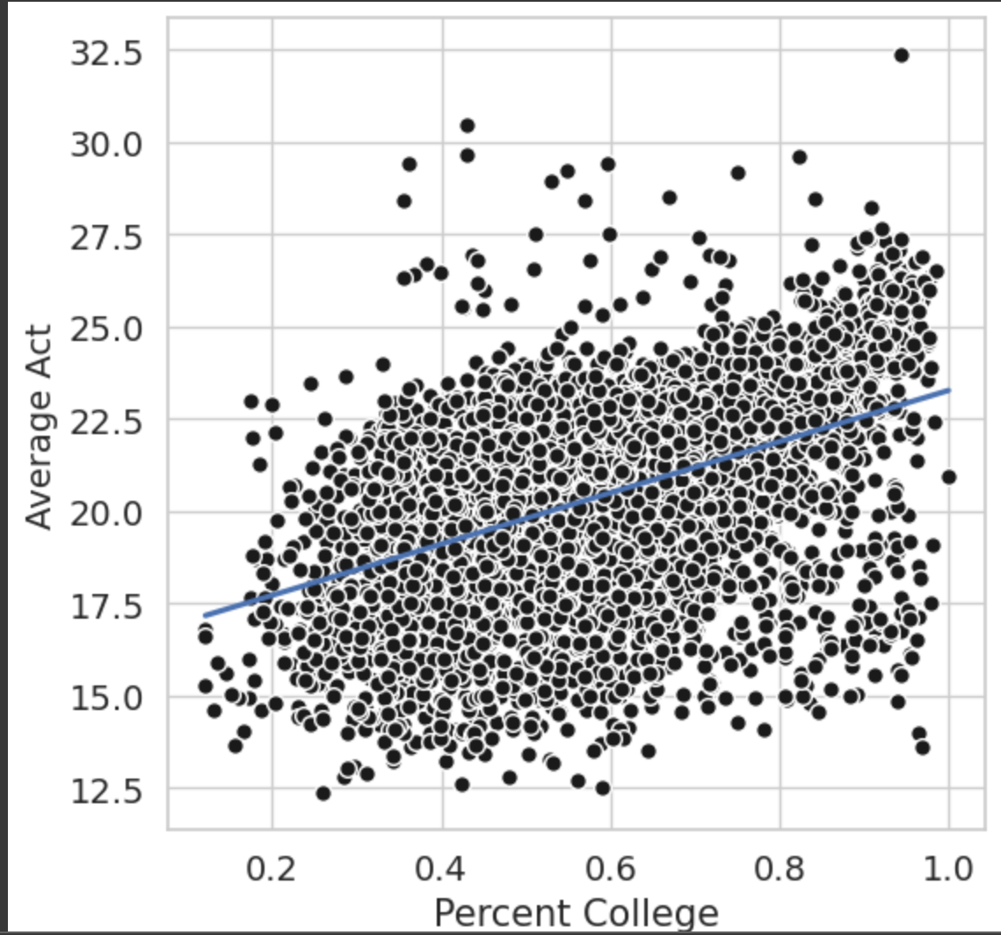
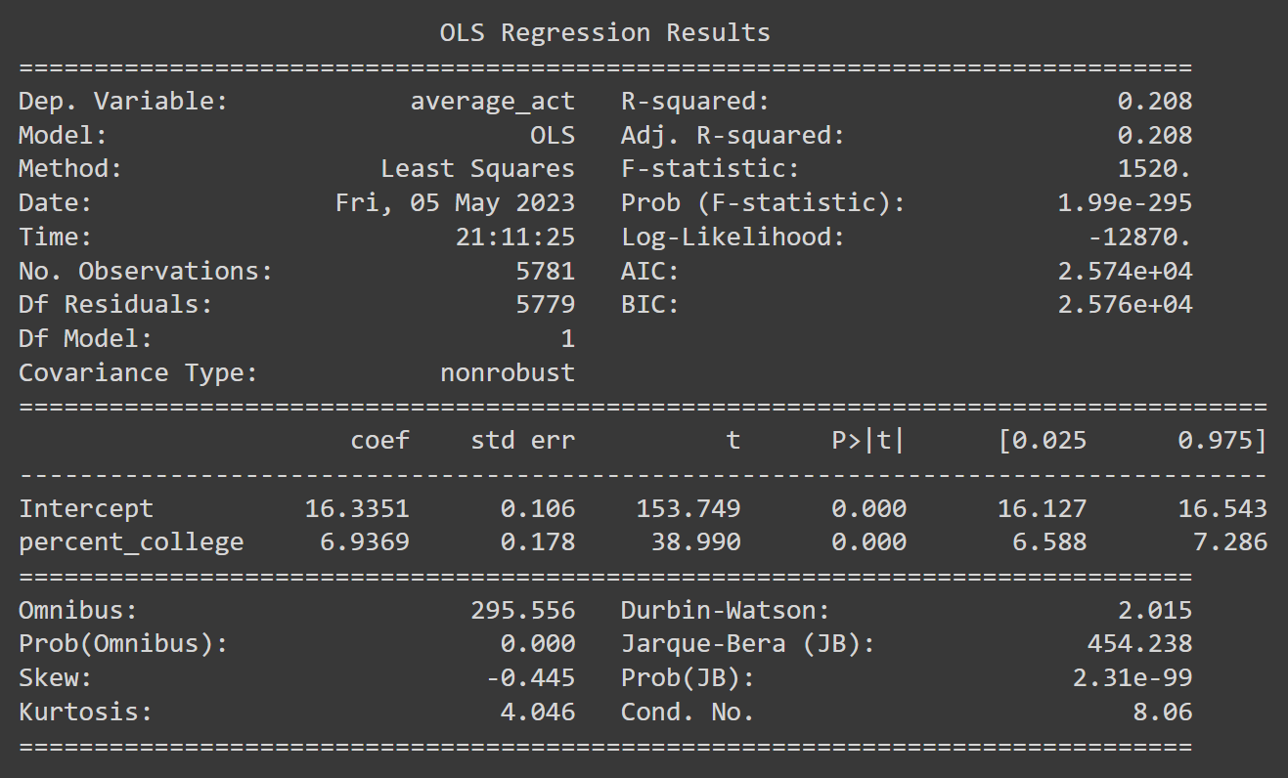
Percent Adults with College Degree

Slide 7
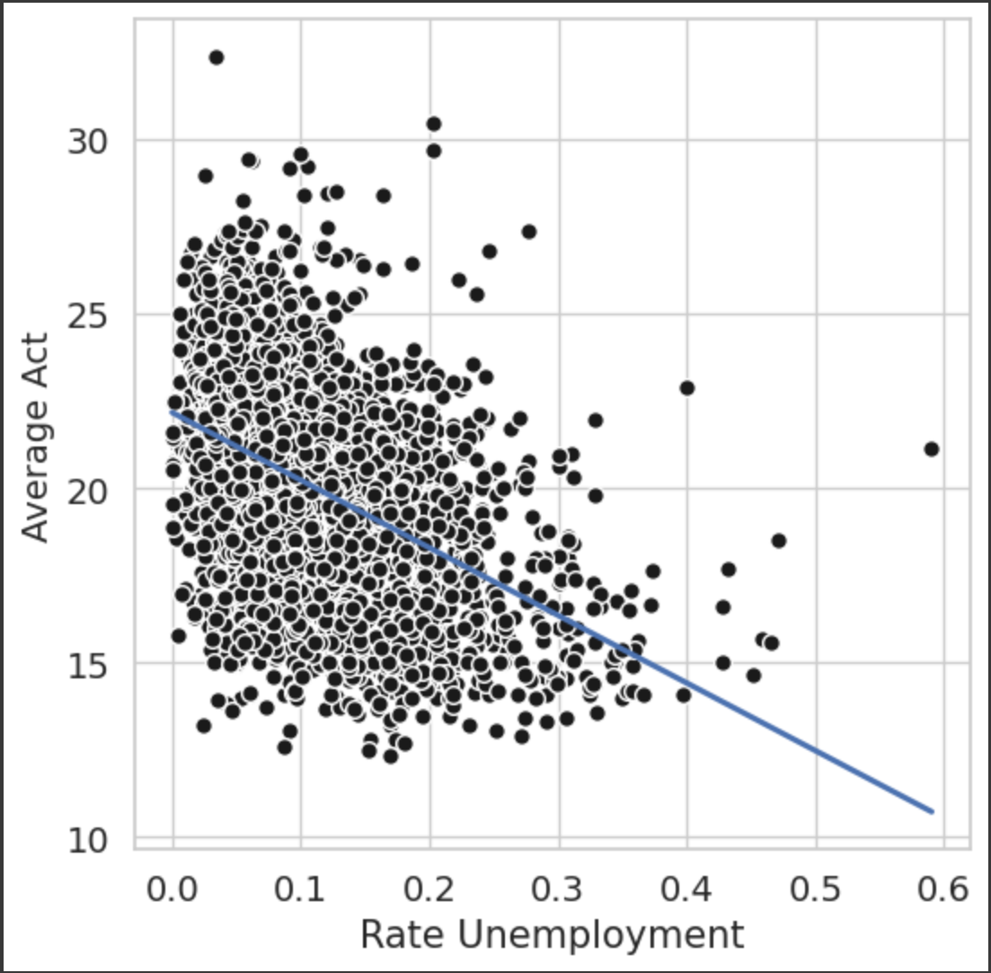
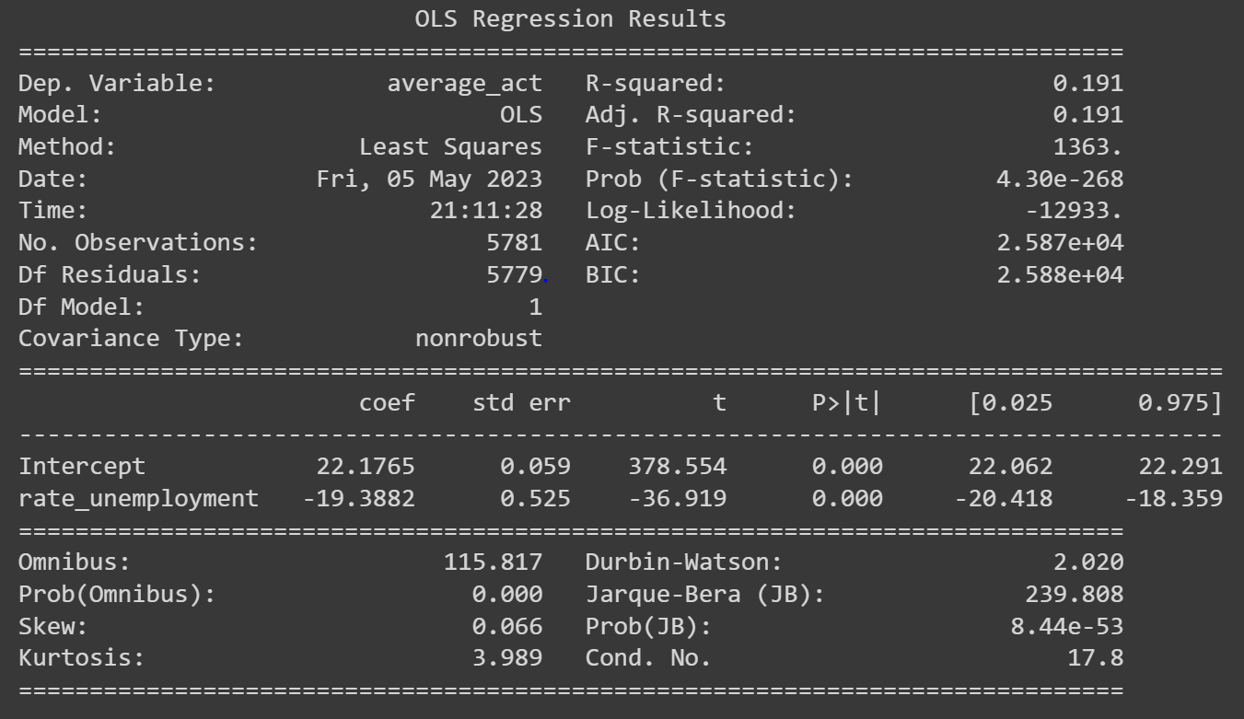
Unemployment Rate

Slide 8
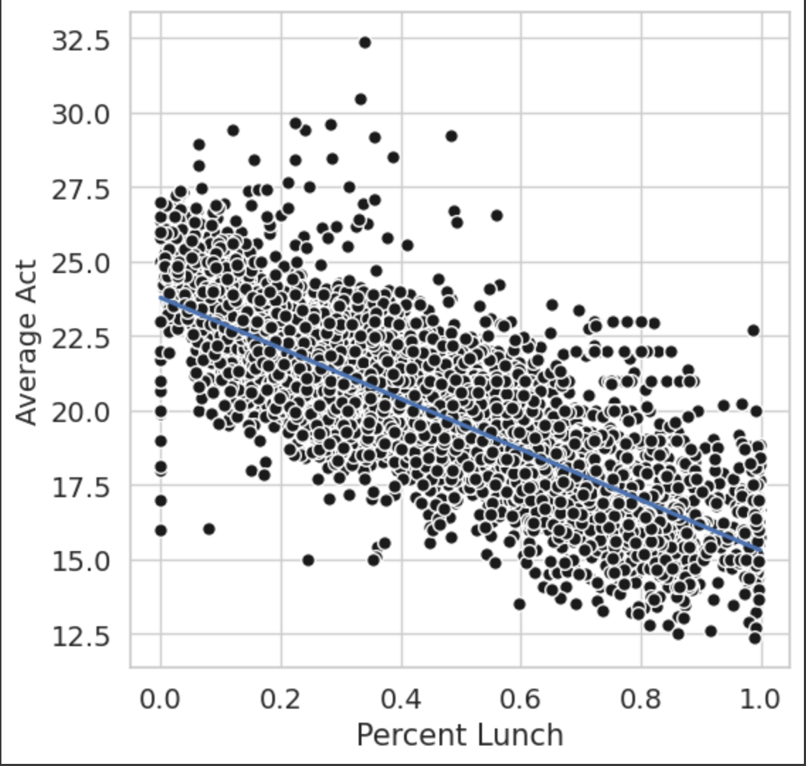
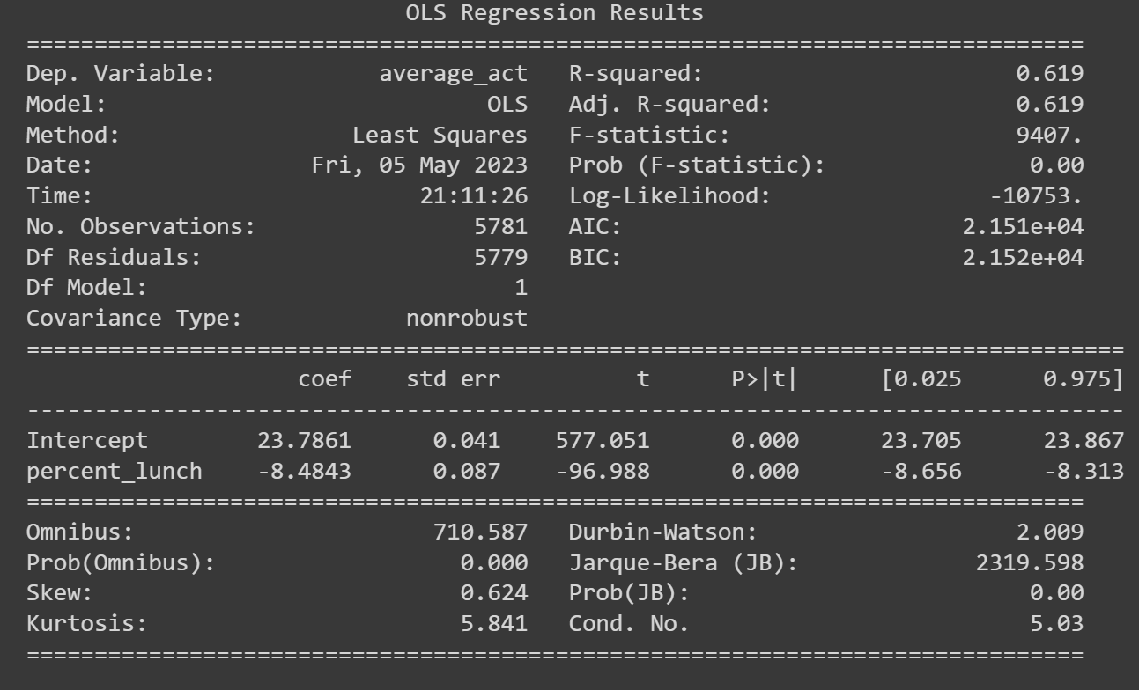
Percent Free and Reduced Lunch

Slide 9
Conclusion
Percent_married and median_income have p-values of around 0.5 and 0.4
Best subset selection indicates that percent_college, percent_lunch, and rate_unemployment are most helpful predictors
Percent_lunch is the best predictor when looking at models with the large r-squared value, but also a significant z-score of -1.8027
Socioeconomic factors do predict school performance
Biased data, missing information, who the data is measured for, etc.

